Slide 1
Apartheid Era Political Cartoons

Slide 2
1.

Slide 3
2.

Slide 4
3.

Slide 5
4. Tambo and Sisulu Oliver Tambo and Walter Sisulu were Mandela's closest colleagues in the long war against apartheid. Tambo died in 1993, and here we see Mandela's grief at Sisulu's passing in 2003.

Slide 6
5.

Slide 7
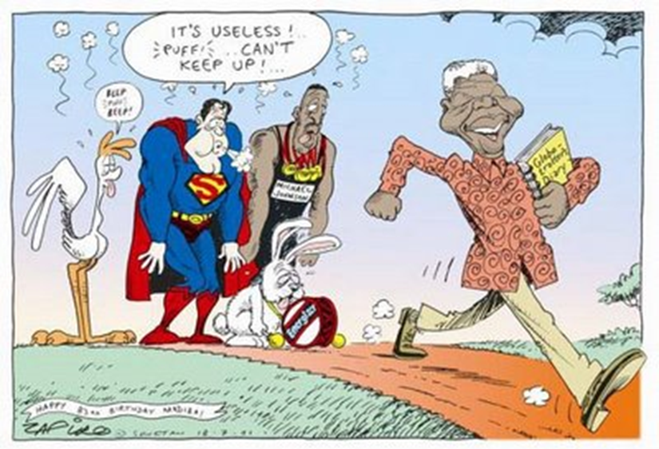
6.

Slide 8
7.

Slide 9
8.

